Slide 1
A Study in Birthrate Mortality
Parris Burton | Mamadou Diallo | Kathryn Davis | Tim McCarthy
Project Description
Investigate birthrates by state and dig into state/region of the country as well as socioeconomic factors that are impacting mortality of mother and or child.
Questions to Be Answered
How does poverty rate affect the maternal mortality rate? Tim McCarthy
What state has the highest and lowest infant mortality rate? Parris Burton
Does race factor into maternal mortality rates? Mamadou Diallo
Is there a correlation between infant and maternal mortality rates? Kathryn Davis
Datasets used
Census API - https://www.census.gov/data/developers/data-sets.html
CDC CSV Data – https://open.cdc.gov/apis.html

Slide 2
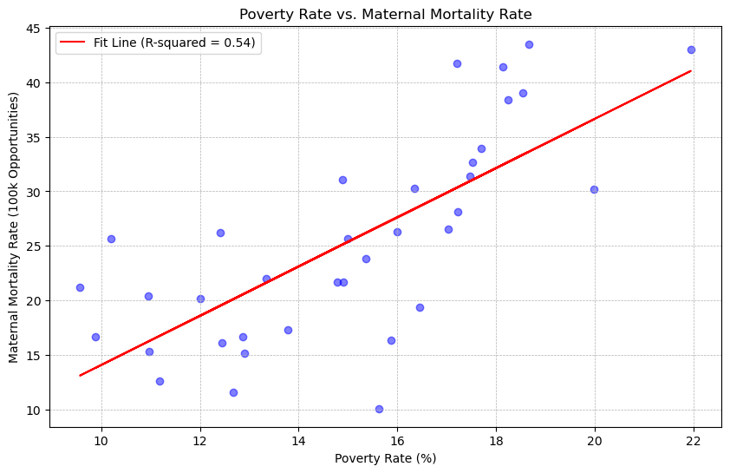
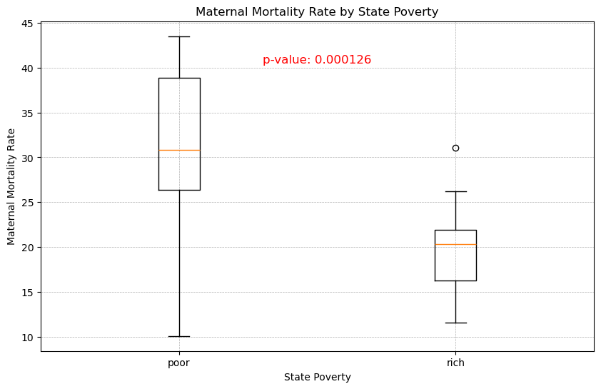
Socioeconomic Impact on Maternal Mortality
Tim McCarthy
Overall Poverty Rate by Maternal Mortality Rate
Using state averages for both poverty rate and maternal mortality rate during and after childbirth, it is clear that there is a direct correlation between the poverty rate in a state and the instances of maternal mortality.
R-squared is 0.54 showing a strong positive correlation between poverty rate and maternal mortality.
When states are binned into rich and poor, women show a 65% higher rate of maternal mortality in poor states than they do in richer states.

Slide 3
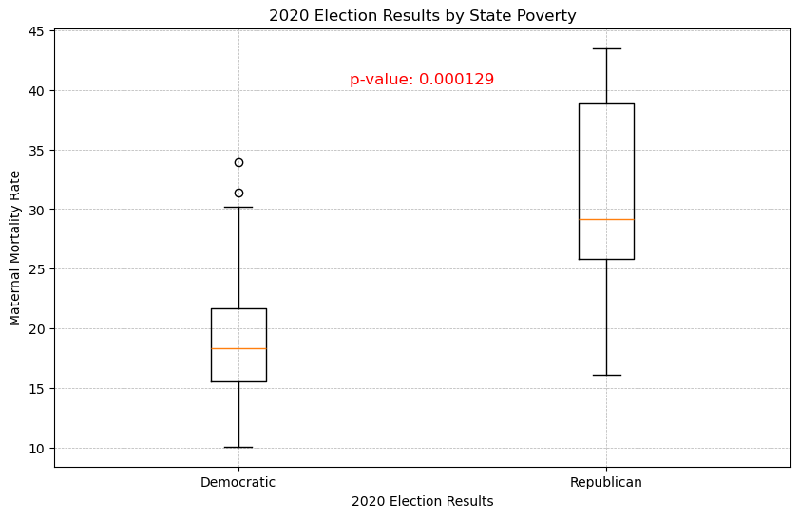
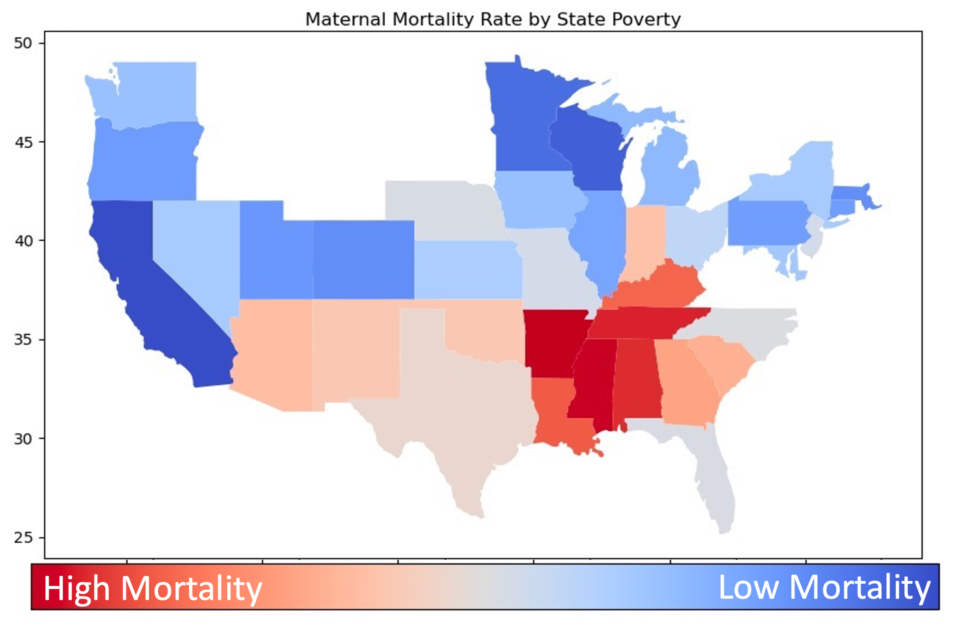
Additional Insights into Maternal Mortality
Tim McCarthy
Comparison Between Red and Blue States on Maternal Mortality
Using data from 2020 presidential election, data was split between Republican and Democratic states.
Women in the poorer states are almost twice as at risk of maternal death than women in richer states.
P-value is less than 0.05, so we can reject the null hypothesis and assume these samples are statistically significant.
Finally, displaying states by high and low mortality shows the southeast corner of the country being the worst.

Slide 4
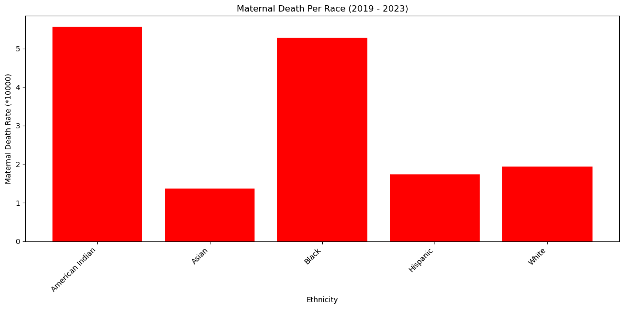
Maternal Mortality Rate by Race
Mamadou Diallo
Using CDC data, we can see that maternal death rates were significantly higher for American Indian and African American mothers.
Asian American, Hispanic, and White mothers show the lowest maternal death rates at less than half the rate of the other two populations.

Slide 5
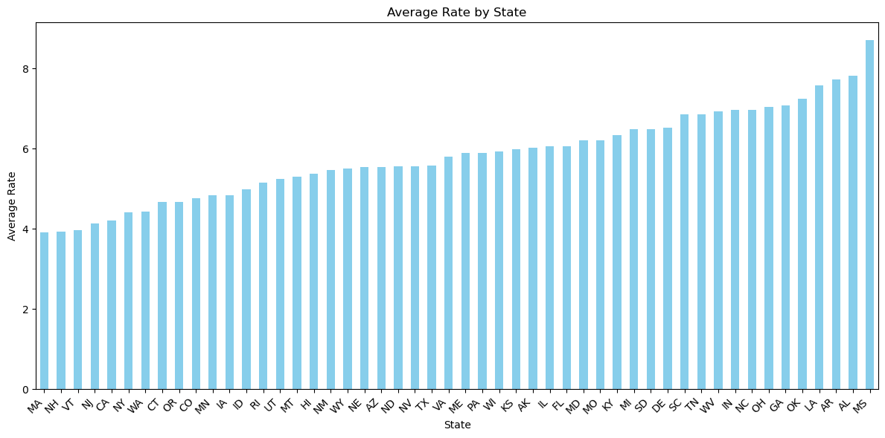
Infant Mortality by US State
Parris Burton
Highest Infant Mortality |  | Lowest Infant Mortality
MS | 8.7 | MA | 3.91
AL | 7.82 | NH | 3.93
AR | 7.72 | VT | 3.97
LA | 7.57 | NJ | 4.14
OK | 7.23 | CA | 4.2
GA | 7.07 | NY | 4.4
OH | 7.03 | WA | 4.42
NC | 6.97 | CT | 4.66
IN | 6.97 | OR | 4.67
WV | 6.93 | CO | 4.76
State with the Highest Infant Mortality Rate: MS Rate: 8.7075 out of every 100,000 pregnancies.
State with the Lowest Infant Mortality Rate: MA Rate: 3.915 out of every 100,000 pregnancies.

Slide 6
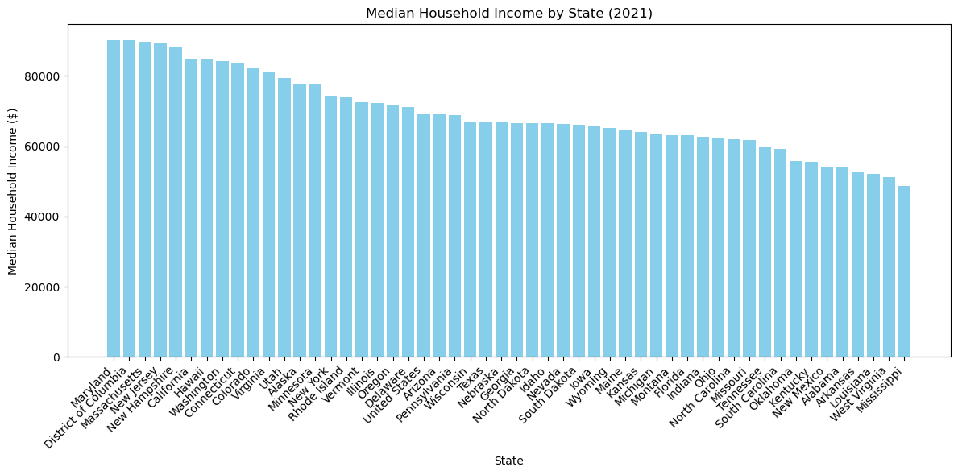
Median Household Income by US State
Parris Burton
Highest Median Household Income
MD | $90,203.00
DC | $90,088.00
MA | $89,645.00
NJ | $89,296.00
NH | $88,465.00
Lowest Median Household Income
AL | $53,913.00
AR | $52,528.00
LA | $52,087.00
WV | $51,248.00
MS | $48,716.00
State with the Highest Household Income: MD Rate: $90,203
State with the Lowest Household Income: MS Rate: $48,716
Maryland & DC have the highest median household income but are not on the top 10 lowest list for infant mortality seen on previous slide.

Slide 7
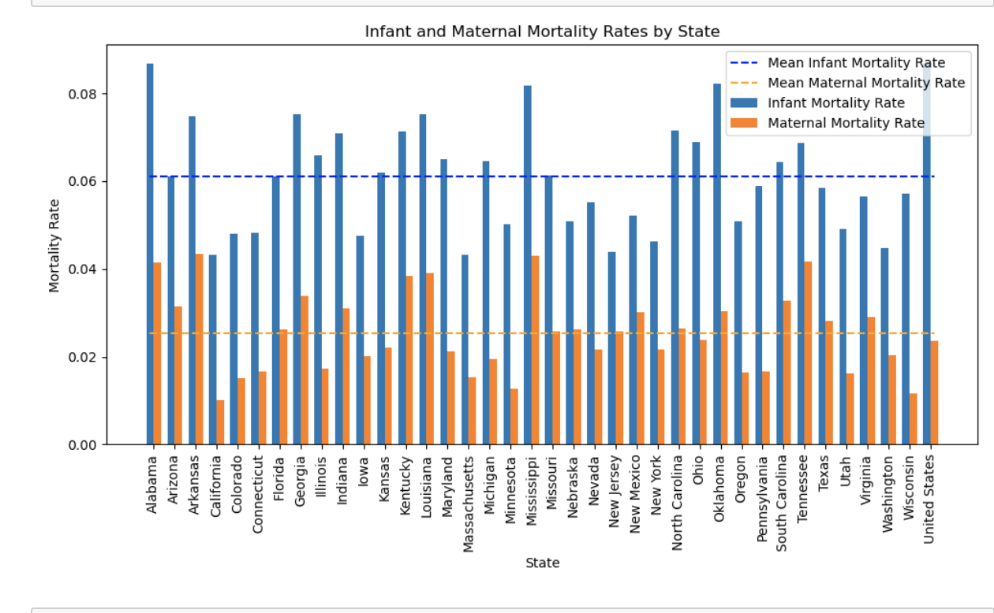
Infant & Maternal Mortality by State
Kathryn Davis
Infant Mortality Rates are consistently higher per state than Maternal Mortality Rates.
The two populations mirror each other showing high states for maternal mortality also being high for infant mortality.

Slide 8
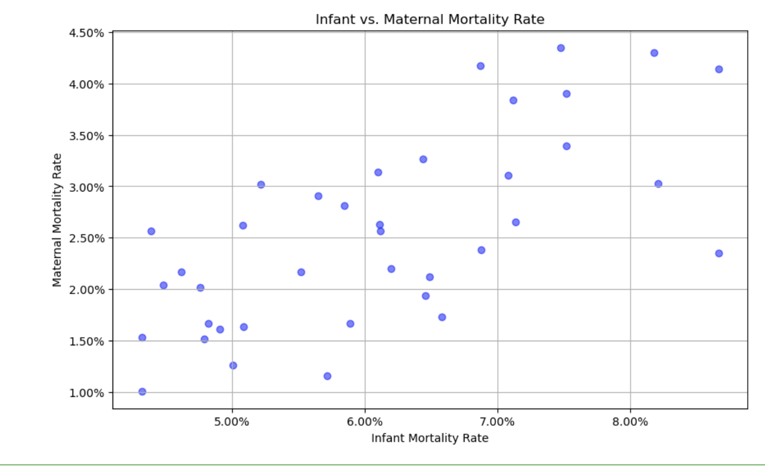
Infant Mortality vs Maternal Mortality
Kathryn Davis
As Infant Mortality Rates increase, so do Maternal Mortality Rates.
In the scatterplot you can tell that, as one increases, the other does as well, indicating that there may be a correlation between the two.

Slide 9
Conclusion
Infant and Maternal mortality are both impacted by wealth level and region of the country.
Infant and Maternal mortality also tend to mirror each other with both going higher in poorer states and improving in wealthier states.

